Slide 1

Permission Impossible
Dead Reckoning Pain
Notes:
Thanks for coming to my talk “Permission Impossible Dead Reckoning Pain” today, where I will be telling you a story about a real life project that I had to do that became the inspiration for this talk

Slide 2



Notes:
So before I begin …. <Acknowledgement of Country”

Slide 3

Shameless Self-Plug
Francis Chung
Co-Organiser of Alt.Net and DDD-AU Meetups
30 years in the industry
My first computer was an Apple II
Am I an Apple Fanboi?
Notes:
… and I’m an Apple Fanboi … despite doing this presentation using a Fake Apple Laptop

Slide 4
Once upon a time ….
Notes:
If you’ve been in the industry for 30 years, all your stories starts with “Once upon a Time …”

Slide 5

Notes:
FreshBooks is an Accounting Platform, main market US/Canada, 1 million plus users worldwide, worked as a Principal Engineer

Slide 6
An Impossible Mission was given

Slide 7
Introduce a new User Class The FIRM Accountant
Notes:
And if you’re wondering what a Firm Accountant is

Slide 8

Not this handsome Accountant
with the firm grip
Notes:
… and the firm stare ….

Slide 9

More like this guy with the Firm Accountant looks …
The world can be accrual sometimes
Notes:
Basically like an external Accountant or Auditor that shares some but not all access rights as your regular accountant

Slide 10
Analysis
933 potential code changes spanning across 6 systems

Slide 11
Analysis
933 potential code changes spanning across 6 systems
Given 1 intern Developer as a resource

Slide 12
Analysis
933 potential code changes spanning across 6 systems
Given 1 intern Developer as a resource
I wasn’t allowed to code

Slide 13
Analysis
933 potential code changes spanning across 6 systems
Given 1 intern Developer as a resource
I wasn’t allowed to code
I had 2 months to deliver

Slide 14
Your project / sanity will self destruct in ….
Notes:
<Hair Pulling Gesture>

Slide 15
Permission Impossible
Dead Reckoning Pain
Notes:
.. and hence … the Title of my talk today

Slide 16

Roughly Speaking …
Notes:
To fast forward 2.5 months later … like most IT Projects this one was later as well …

Slide 17
Project Delivered!
Notes:
I actually delivered the project, and I didn’t break production as I predicted

Slide 18

On Reflection …
Notes:
So when I got a chance to lie down and reflect upon what I did, what I really should have done was …

Slide 19
What I should have done
Notes:
… is to jump out of the building and ran for my life and my sanity. The stress of delivering thisproject was pretty intense, and I could see me repeating this exercise again. FBs had new features on their roadmap that would require new User Classes and this exercise would be surely repeated. And guess who’s doing this project again?

Slide 20
There has to be a better way !
Notes:
And on reflection I thought, there has to be a better way of introducing a new user class to the system. And I could see this was going to happen again in the coming months as FBs introduced new features and inevitable new user classes along the way.

Slide 21
THE END - Part 1
Notes:
So I’ll be talking about a better way of doing this in the next segment of the talk

Slide 22
Part 2 - Deeper Dive

Slide 23

Agenda
Permissions
Intro - Auth vs Authz
Different Access Control Models
Code Examples
Q&A at the end

Slide 24
Authentication (AuthN)
vs
Authorization (AuthZ)
Notes:
When you’re talking about Application Security, permissions, identity etc, what you’re really talking about is Authentication and Authorization, which both go hand in hand. But it’s common for people to confuse the 2. So let’s first talk about what these 2 things really are.

Slide 25
Authentication -
Are you who you say you are?

Slide 26
Authentication -
Notes:
Ethan Hunt, what a nightmare to Authenticate, eh?

Slide 27
Authorization - As user X =>
What are you allowed to do? What AREN’T you allowed to do?
Notes:
We’ve all been with with a partner that likes to say stamp her authority and say No

Slide 28
Authentication (AuthN)
vs
Authorization (AuthZ)

Slide 29
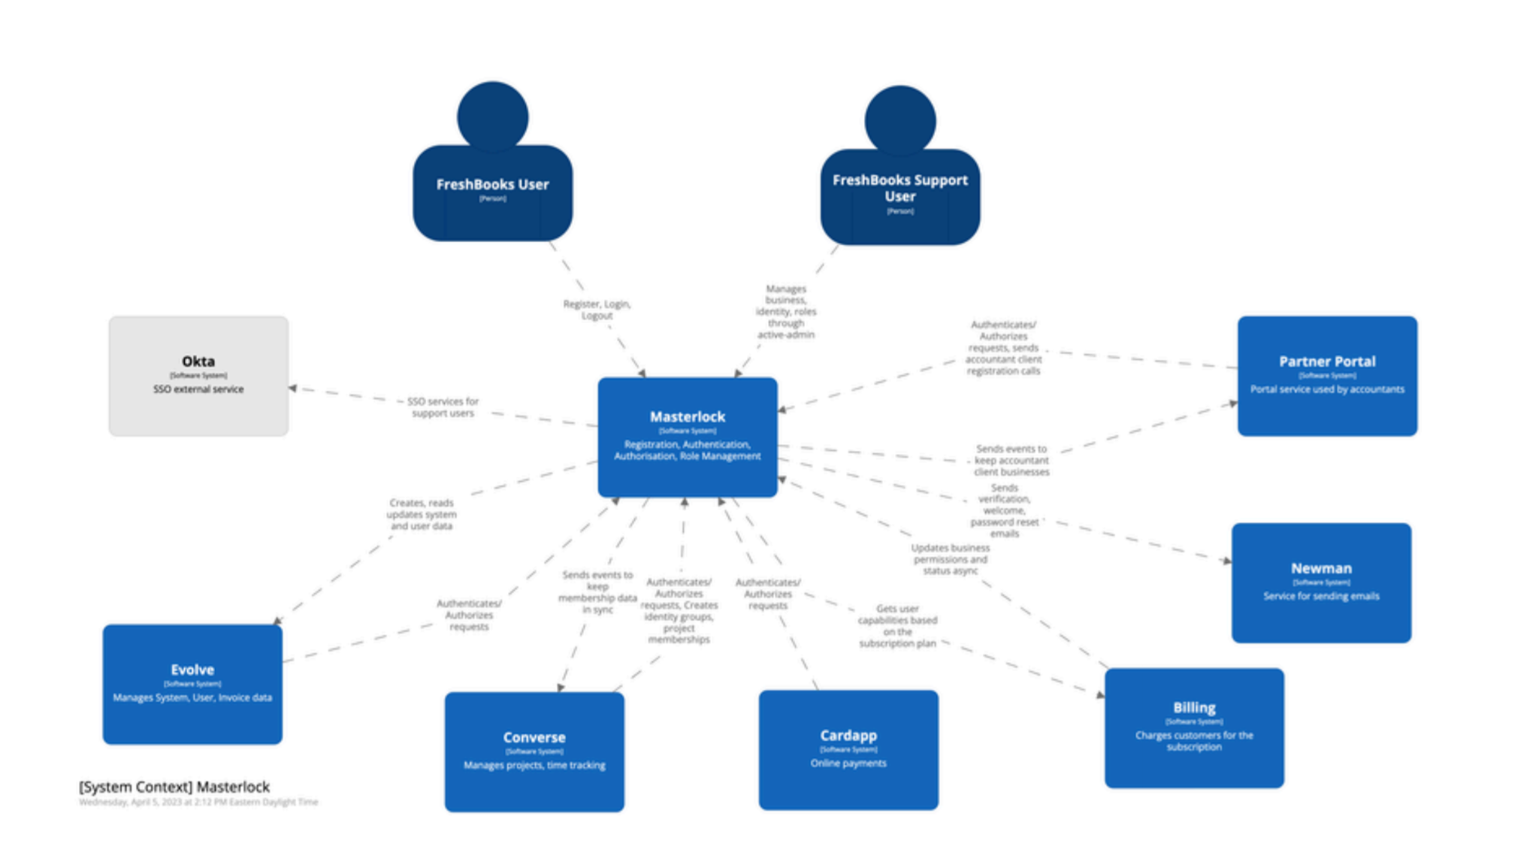
Tech Stack @ FreshBooks
]
Notes:
Before we start getting deeper, I wanted to quickly paint you a picture of how Authorization worked at FBs. Now, I know the picture is slightly blurry here. The main thing to note is that all systems are pointing to the system in the middle called MasterLock MasterLock is FB’s Core AuthN + AuthZ System.

Slide 30
Tech Stack @ FreshBooks
]
Everything depends on Masterlock
Notes:
So you can imagine, everything depended on Masterlock
Let’s look at an example of the 1 of the 933 places I had to check

Slide 31
Tech Stack @ FreshBooks
]
Express.js, React - UI
Python - Backend
Ruby on Rails - Auth + Authz
Notes:
So let’s look at an example of the 1 of the 933 places I had to check

Slide 32
Masterlock - Center of it all
]
Masterlock - Ruby on Rails, Devise (Auth), Pundit (AuthZ)
50ms is expected norm for Authz calls
FBs had to increase DataDog budget 250ms -> 600ms
-> Authz Calls were taking up to 600ms
Increased AuthZ calls impacting UX negatively
Decentralised Mess -> RBAC Data with MasterLock (Pundit), RBAC Logic stored with each Application
Notes:
So let’s look at an example of the 1 of the 933 places I had to check

Slide 33
Typical Code for checking permissions
def put(self, business_uuid):
if not self.permission.can_update():
raise ForbiddenError
# ... do some updates ...
class <BusinessUnit>Permission(BasePermission):
def can_read(self):
return self.role in [
self.BUSINESS_OWNER_ROLE,
self.BUSINESS_PARTNER_ROLE,
self.ACCOUNTANT_PARTNER_ROLE,
]
def can_update(self):
return self.role in [
self.BUSINESS_OWNER_ROLE,
self.BUSINESS_PARTNER_ROLE,
self.ACCOUNTANT_PARTNER_ROLE,
]
Notes:
So let’s look at an example of the 1 of the 933 places I had to check

Slide 34
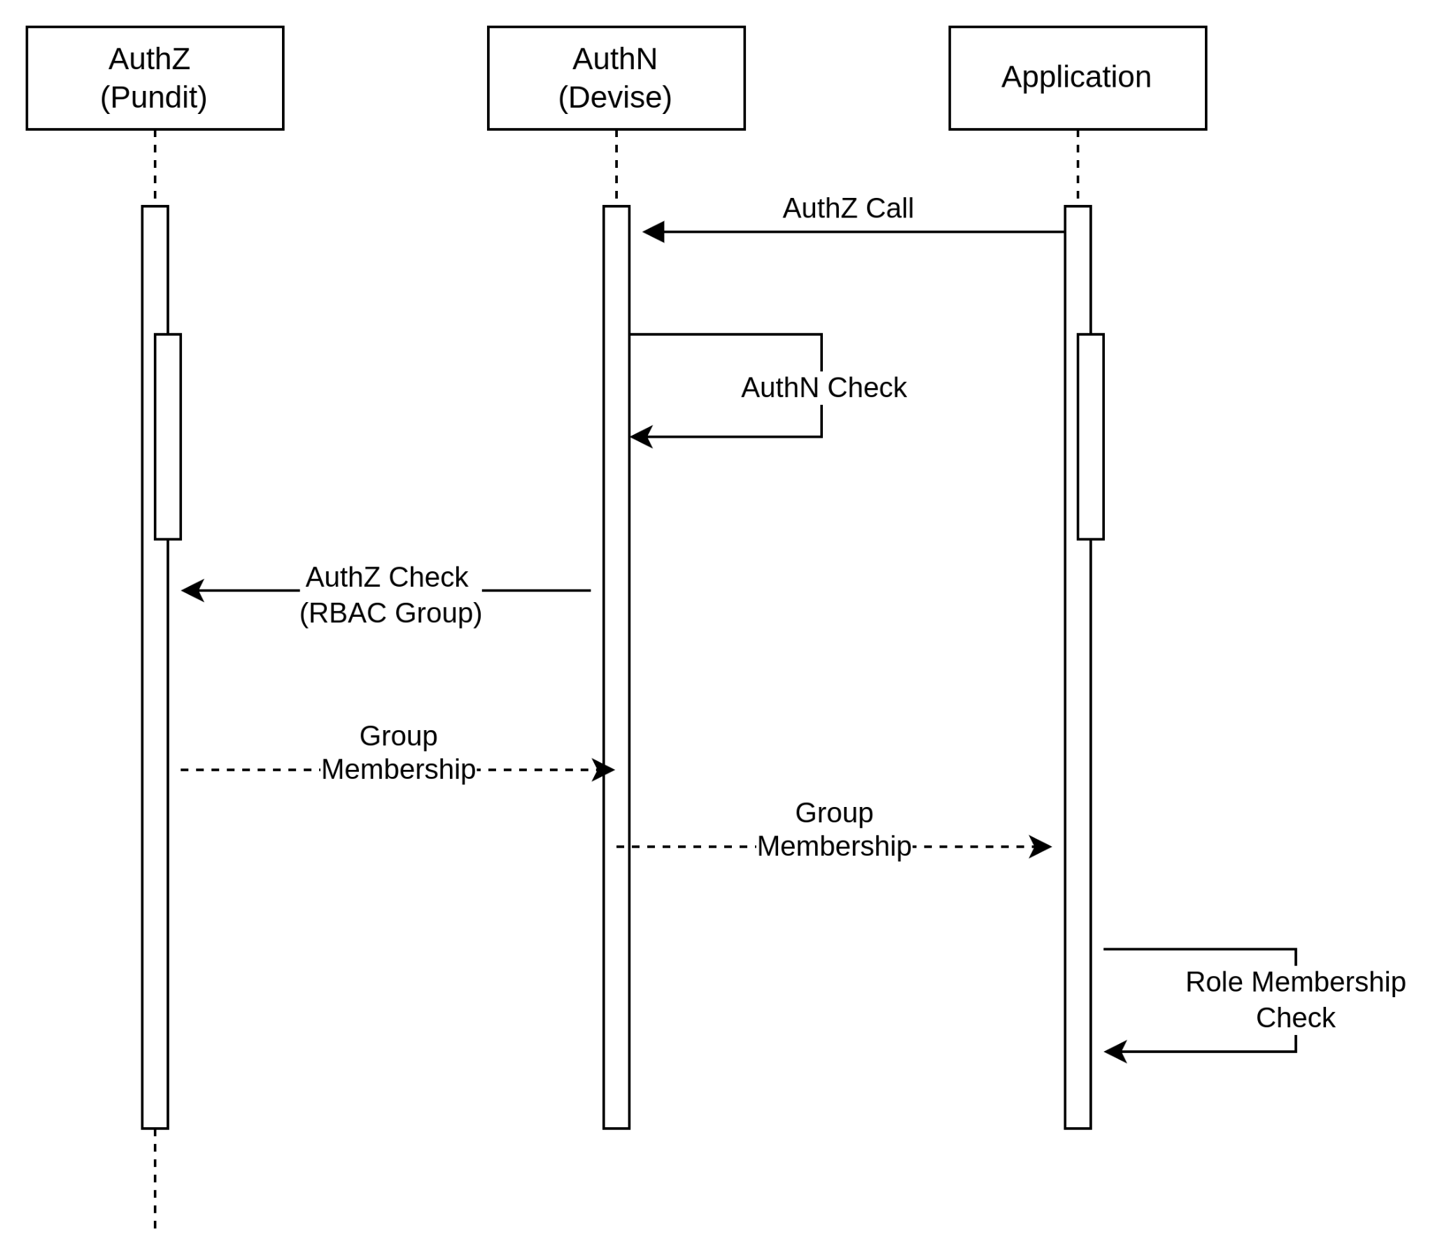
An AuthZ Call @ FreshBooks
Notes:
Key things to note is that we have 3 places and multipel calls doing the whole AuthN + AuthZ sequence. This sequence is taking up to 600ms

Slide 35
Role Based Access Control (RBAC)
def put(self, business_uuid):
if not self.permission.can_update():
raise ForbiddenError
# ... do some updates ...
class <BusinessUnit>Permission(BasePermission):
def can_read(self):
return self.role in [
self.BUSINESS_OWNER_ROLE,
self.BUSINESS_PARTNER_ROLE,
self.ACCOUNTANT_PARTNER_ROLE,
]
def can_update(self):
return self.role in [
self.BUSINESS_OWNER_ROLE,
self.BUSINESS_PARTNER_ROLE,
self.ACCOUNTANT_PARTNER_ROLE,
]
Role Based Security
Role based Access Control
(RBAC)
Notes:
Everyone has seen this type of code before right? Imagine changing / analysing 933 instances of code like this throughout your entire SAAS application

Slide 36
Pros & Cons with RBAC (Role based)
Pros
Simple
Easy to implement
Great for small/medium apps
Well defined Permission Set that doesn’t change

Slide 37
Pros & Cons with RBAC (Role based)
Pros
Simple
Easy to implement
Great for small/medium apps
Well defined Permission Set that doesn’t change
Cons
Not Scalable for Enterprise / SAAS
Difficult to change or introduce new permissions
Simple, Low Granular Permissions
Tight Coupling

Slide 38
Are there Alternatives out there?
Notes:
Just filled my Cat meme Quota. Check.

Slide 39
Attribute Based Access Control (ABAC)
In a Nutshell : -
Method of doing Access Control over attributes across 4 areas using policies
Subject (User)
Resource
Action
Environment
Notes:
So during my research, I can across something called ABAC.

Slide 40
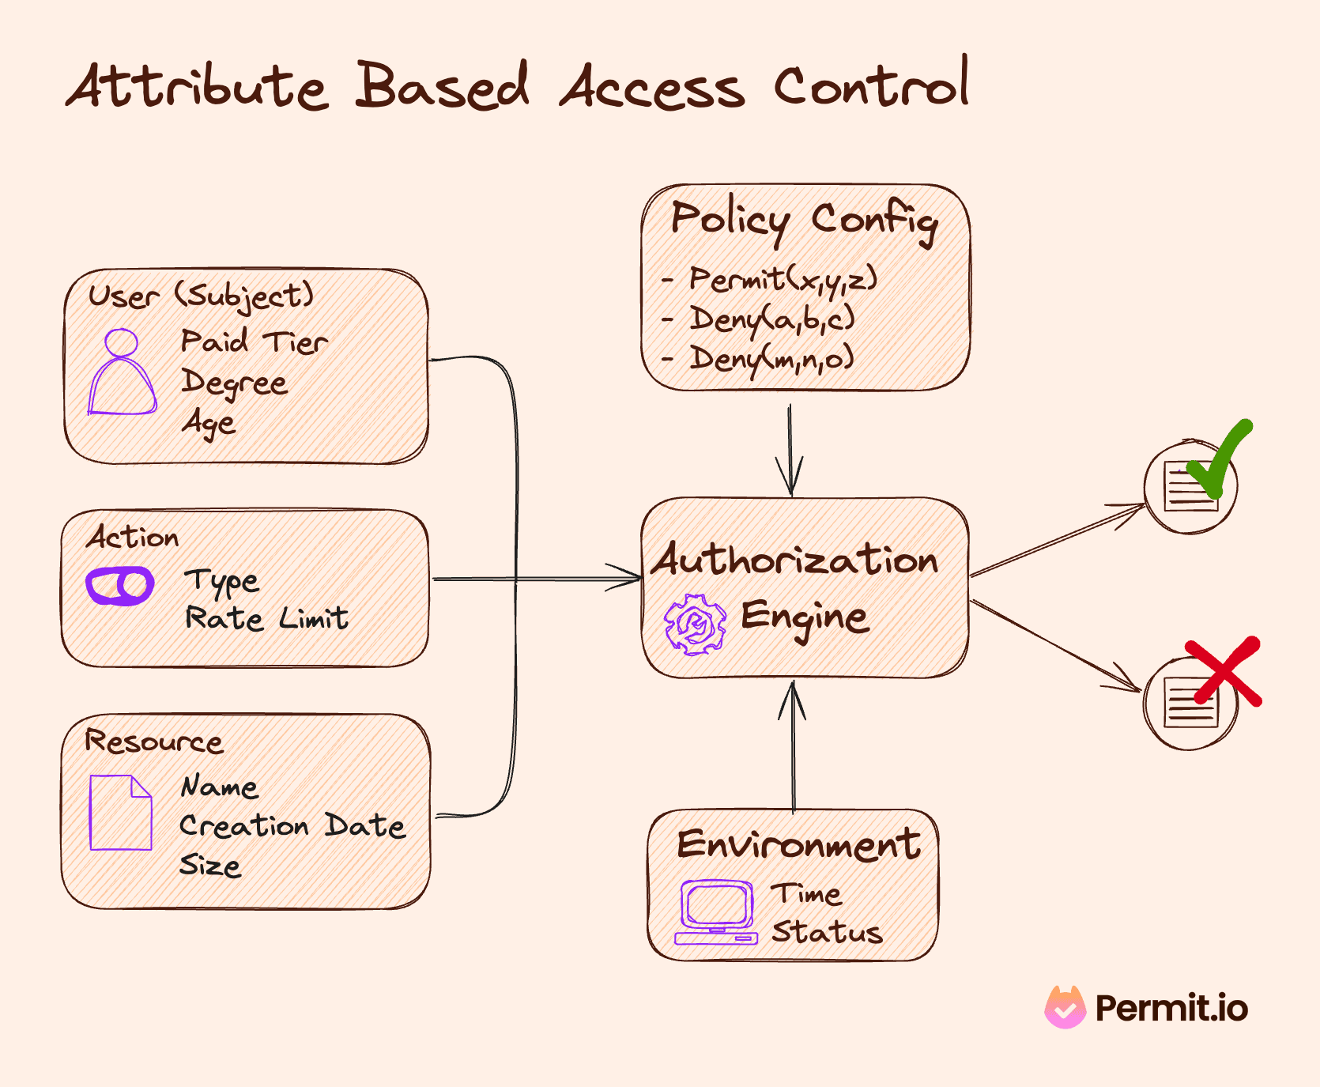

Slide 41
Attribute Based Access Control (ABAC)
Pros
Granular / Flexible Permissions
Scalable
Better Security + Compliance
Centralised

Slide 42
Attribute Based Access Control (ABAC)
Pros
Granular / Flexible Permissions
Scalable
Better Security + Compliance
Centralised
Cons
Complex!
Performance - Latency
XACML - Extensible Access Control Markup Language
Notes:
XACML seems to be standard way of doing ABAC

Slide 43
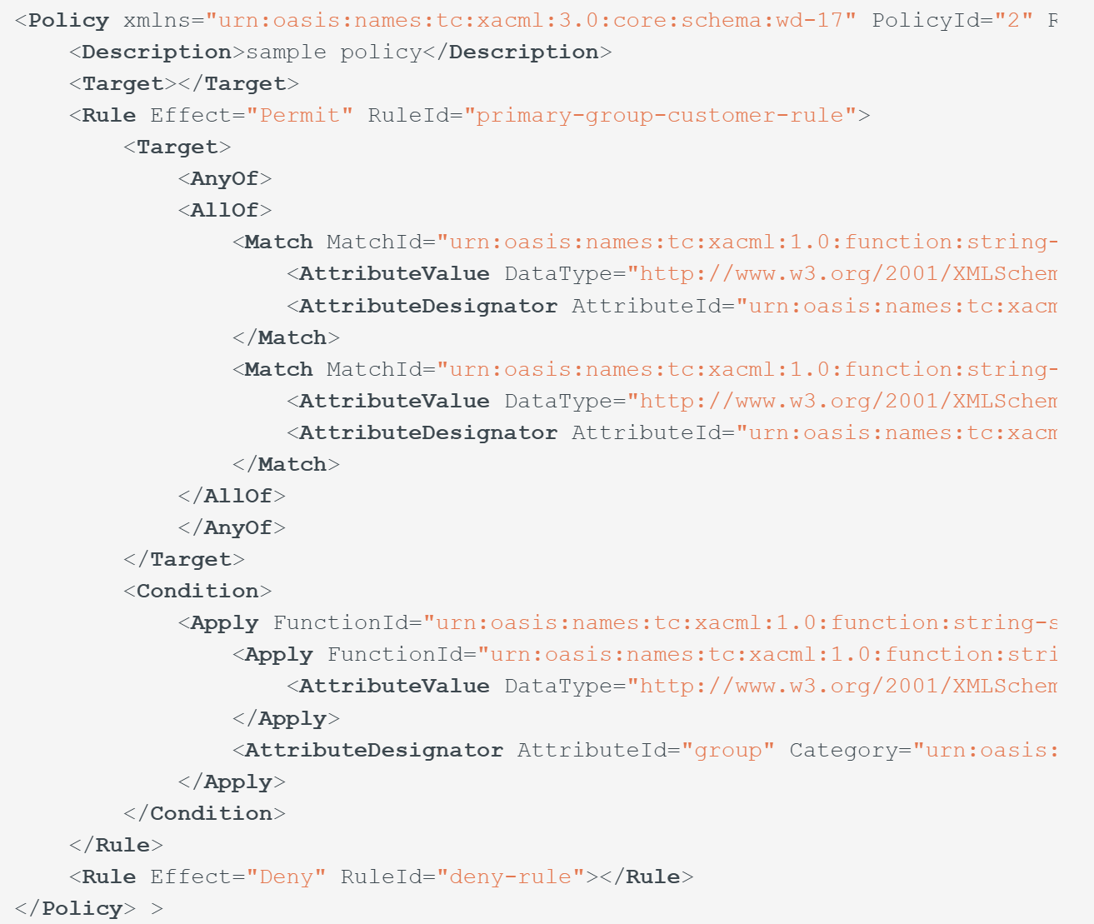
ABAC - XACML Example
Notes:
“XML is like violence: if it doesn’t solve your problem, you aren’t using enough of it.” - Chris R Maden, American Data Analyst & Programmer

Slide 44

Trying to sell XACML to Devs
Notes:
Is like trying to sell a really bad trade to a rival to your angry and confused fan base. Any Luka / Mavericks / NBA fans out here?

Slide 45
Notes:
And quickly came to the conclusion, this is not THE way, if I want to live

Slide 46
Google Zanzibar
Notes:
Then I came across something called Google Zanzibar. ….. And you might be thinking …

Slide 47
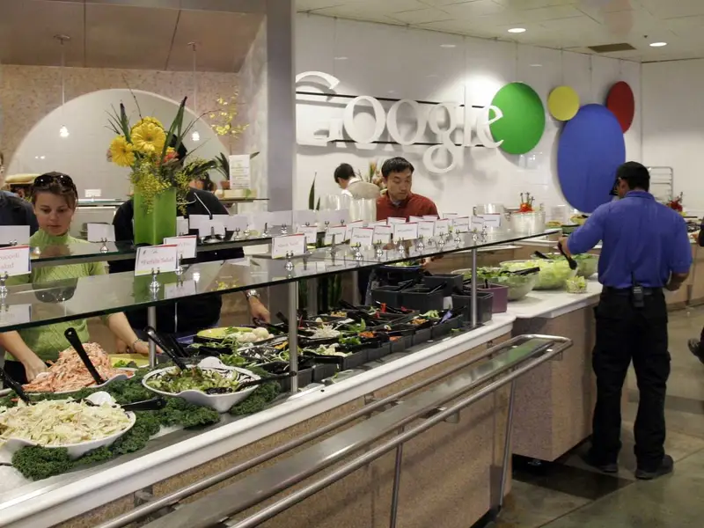
Google Zanzibar
Notes:
… is it their famous salad bar in their staff restaurants? Sadly, it isn’t.

Slide 48
Google Zanzibar
Access Control System for all of Google’s Services (Internal + External)
Calendar, Cloud, Drive, Maps, Photos, and YouTube etc
95th-percentile latency of less than 10 milliseconds
Availability of 99.999% over 3 years
Notes:
50ms is considered a good time for an Authorisation call. In FBs, we had to increase our DataDog latency budget from 250ms to 600ms.

Slide 49
Google Zanzibar
Access Control Server for all of Google’s Services
Calendar, Cloud, Drive, Maps, Photos, and YouTube etc
95th-percentile latency of less than 10 milliseconds
Availability of 99.999% over 3 years
2 trillion relation tuples that occupy close to 100 terabytes
> 10 million client queries per second (QPS)
10,000 servers organized in several dozen clusters
Planetscale Numbers!
Notes:
50ms is considered a good time for an Authorisation call. In FBs, we had to increase our DataDog latency budget from 250ms to 600ms. Now you need to be wary, when you see the word PlanetScale bandied about

Slide 50

Notes:
Should be very wary when someone mentions PlanetScale, because this is what it usually means. Remember Kubernetes? Who’s used Kubernetes and got their fingers burnt? Netflix and Microservices anyone?

Slide 51
Pros & Cons with RBAC (Role based)
Pros
Simple
Easy to implement
Great for small/medium apps
Well defined Permission Set that doesn’t change
Cons
Not Scalable for Enterprise / SAAS
Difficult to change or introduce new permissions
Simple, Low Granular Permissions
Tight Coupling
Notes:
So I want to re-emphasise that if your use case lies within the blue points above, you should probably stick to RBAC, but perhaps use a solution that doesn’t imbed those Authorization logic in code as I demonstrated earlier

Slide 52

Google Zanzibar
Relationship based Access Control (ReBAC)
Notes:
In my earlier slide, I mentioned 2 trillion relation tuples, so that was a hint of what Zanzibar uses underneath

Slide 53
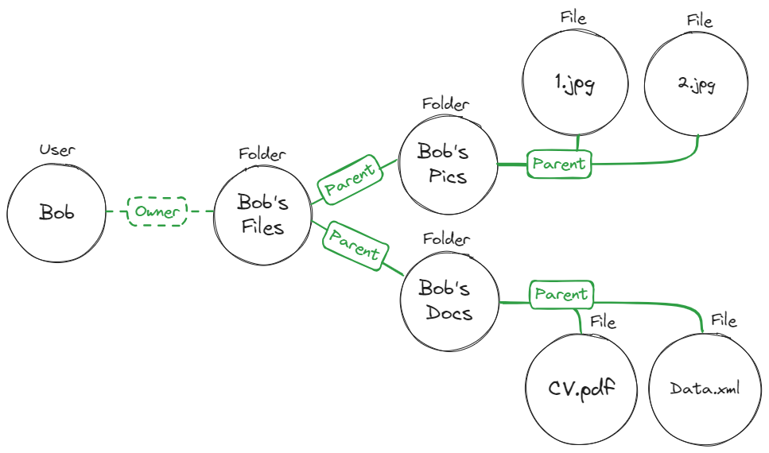

Relationship Based Access Control (ReBAC)
Notes:
At the heart of ReBAC, as the name implies is describing relationships between objects as a graph or a tuple

Slide 54
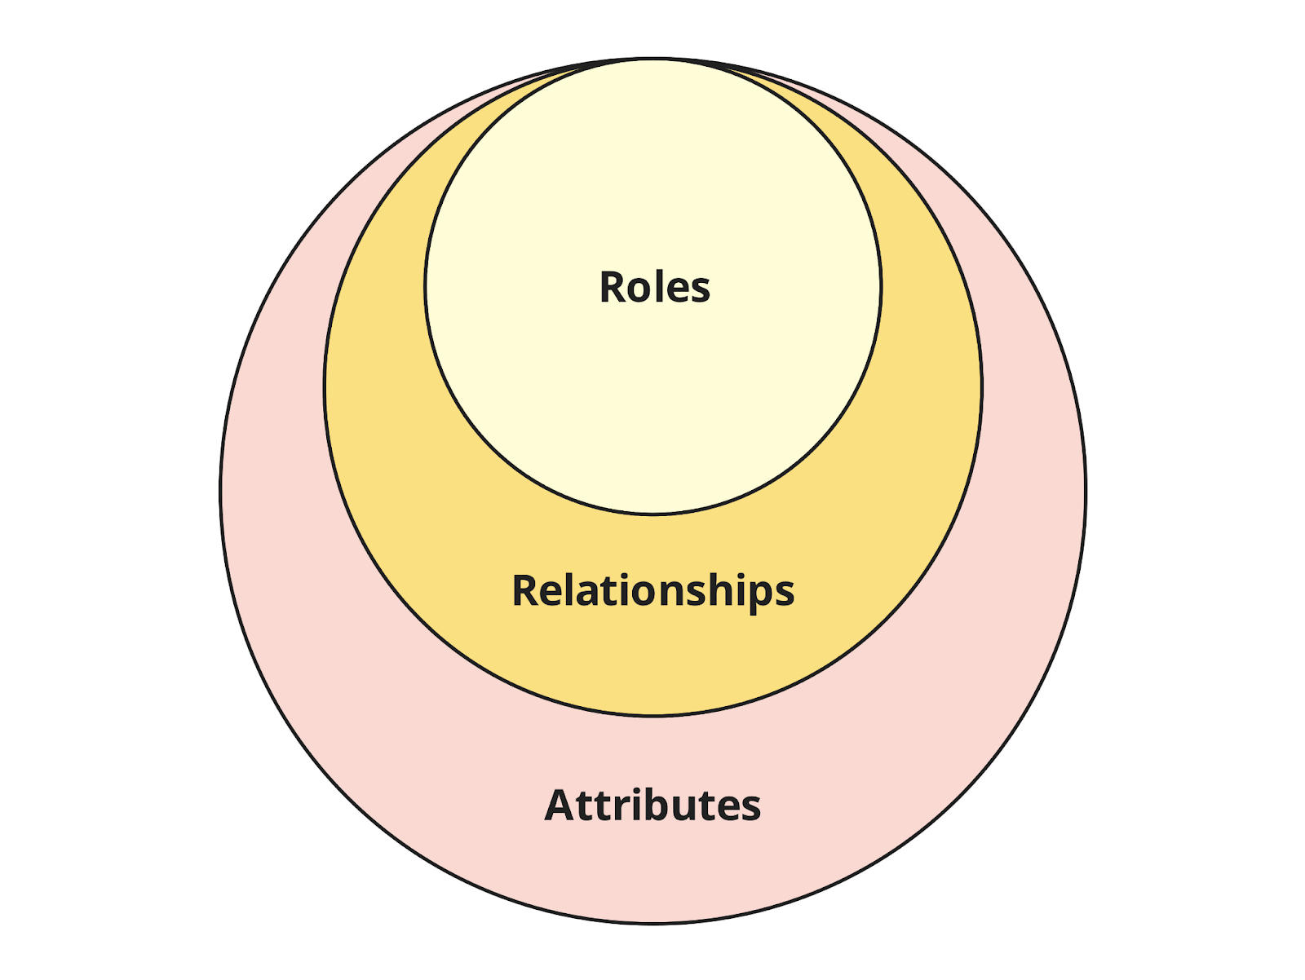

RBAC vs ReBAC vs ABAC - Concepts
Notes:
From conceptual viewpoint, Attributes > Relationships > Roles. If you’re thinking about moving from RBAC to ReBAC, the above graph tells you that a natural migration path exists

Slide 55
Relationship based Access Control (ReBAC)
Pros
Granular / Flexible Permissions
Scalable
Visual | Graphical
Centralised

Slide 56
Relationship based Access Control (ReBAC)
Pros
Granular / Flexible Permissions
Scalable
Visual | Graphical
Centralised
Cons
Relations can be complex to map
Learning curve - Graph Theory
Not as granular as ABAC
Auditing - Could be challenging
Notes:
XACML seems to be standard way of doing ABAC

Slide 57
Google Zanzibar Solutions
Open Source
SpiceDB
OpenFGA
Ory / Keto
Permify
Permit.io
Topaz
Commercial
Oso
Auth0 / Okta (OpenFGA)
Notes:
Google Zanzibar is not open source, but they did release a white paper on it. 50ms is considered a good time for an Authorisation call. In FBs, we had to increase our DataDog latency budget from 250ms to 600ms.

Slide 58
Google Zanzibar Solutions
Open Source
SpiceDB
OpenFGA
Ory / Keto
Permify
Permit.io
Topaz
Commercial
Oso
Auth0 / Okta (OpenFGA)
Notes:
Google Zanzibar is not open source, but they did release a white paper on it. I’ll be doing a quick demo showcasing ReBAC concepts in Topaz

Slide 59

Topaz
Open Source
Supports Open Policy Agent (OPA) and Zanzibar
Supports RBAC, ABAC and ReBAC
Policies are expressed as code
Notes:
Open Policy Agent is an Cloud Native Computing Foundation Project that provides a way of declaratively writing policies as code (think Terraform for Policies)

Slide 60
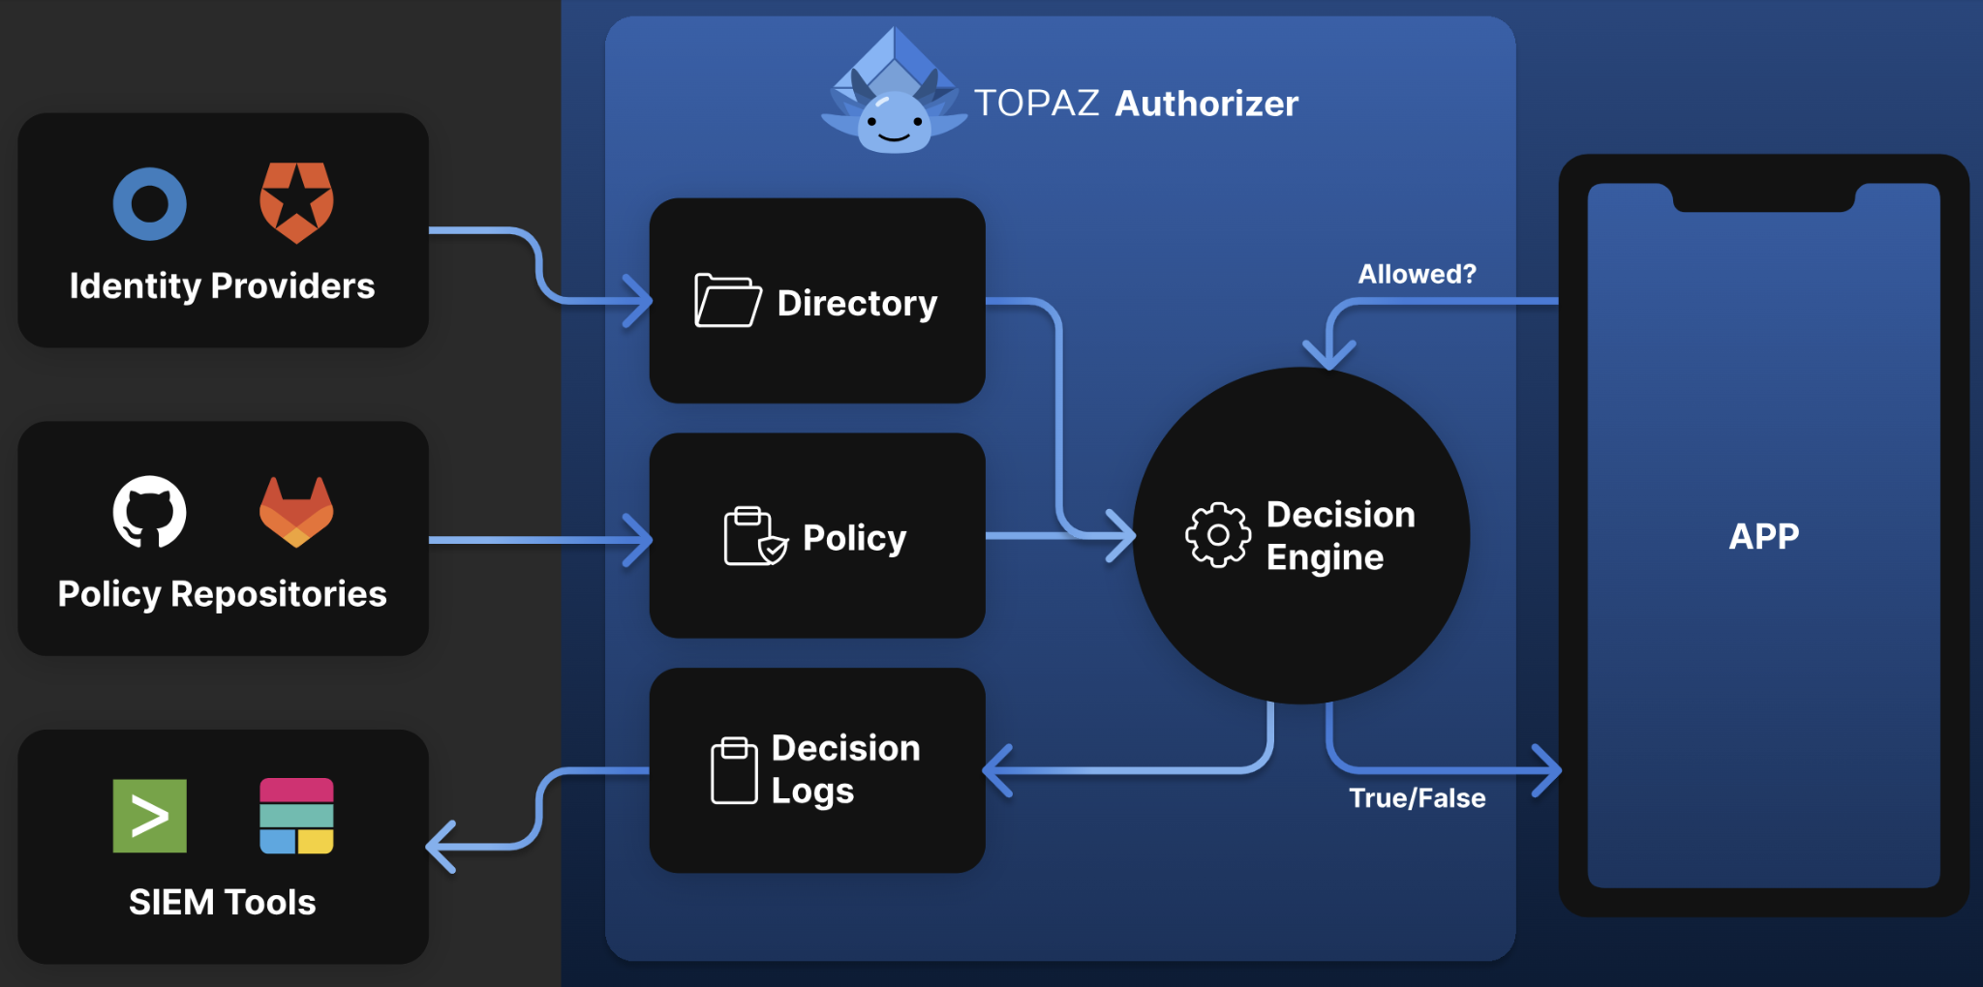
Topaz Architecture
Notes:
ID Providers does the Auth part (and you can connect external ones) Policy Repos are your data stores of your policies SIEM - Security Information and Event Managment - Real-time visibility across an organization's information security systems

Slide 61
Topaz - RBAC Example
allowed {
ds.check({
"object_type":"tenant",
"object_id": input.resource.tenant_id,
"relation": "viewer",
"subject_type": "",
"subject_id": input.user.id,
})
}
Notes:
It’s using json, not violent XML as you can see. And this code sample is an example authorization check to see if the Subject is able to view Tenant’s detail by checking to see if it’s in the viewer membership

Slide 62
Topaz - ReBAC Example
allowed {
ds.check({
"object_type": "document",
"object_id": input.resource.doc_id,
"relation": "can_read",
"subject_type": "user",
"subject_id": input.user.id,
})
}
Notes:
This check is to see if the user has a “can_read” relationship defined against this particular document

Slide 63
Topaz - ABAC Example
allowed {
ns := time.now_ns()
day := time.weekday(ns)
day == data.workdays[_]
input.user.properties.department == "Sales"
}
Notes:
This is basically a policy to check if the person being checked is working in Sales and during working hours

Slide 64
Topaz - ASP.NET Core Example
//Startup.cs
using Aserto.AspNetCore.Middleware.Extensions;
using Aserto.AspNetCore.Middleware.Policies;
// ...
//Aserto options handling
services.AddAsertoAuthorization(options => Configuration.GetSection("Aserto").Bind(options));
//end Aserto options handling
services.AddAuthorization(options =>
{
options.AddPolicy("Aserto", policy => policy.Requirements.Add(new AsertoDecisionRequirement()));
});
// ...
app.UseAuthorization();
//<Some>Controller.cs
[ApiController]
[Route("/todos")]
public class GetTodosController : ControllerBase
{
//...Some code
[HttpGet]
[Authorize("Aserto")]
public async Task<IEnumerable<TodoResource>> GetAllAsync()
{
var todos = await _todoService.ListAsync();
var resources = _mapper.Map<IEnumerable<Todo>, IEnumerable<TodoResource>>(todos);
return resources;
}
}
Notes:
<Show Code exam ple>

Slide 65
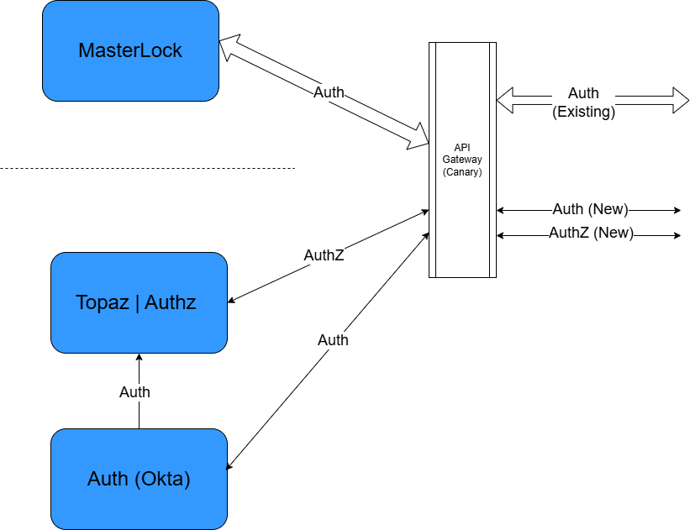
FreshBooks - Unrequited Vision
Notes:
<Show Code exam ple>

Slide 66
FreshBooks - Unrequited Vision
Notes:
<Show Code exam ple>

Slide 67
Q & A
If I didn’t answer your question,
please send me a message on LinkedIn
https://www.linkedin.com/in/francischung/

Slide 68
The End
There are solutions out there. No need to jump out of buildings!
Notes:
No matter how mission impossible a situation might be, there are always solutions out there.

Slide 69



Acknowledgements
Ben Robinson (AKA the intern Developer) -
Now a fully fledged FullStack Ruby/TS/Python Developer
Chris Simon - DDD-AU
George Jayaratnam - Quant Risk Management, Data Engineering

Slide 70
References
https://www.permit.io/blog/what-is-abac
https://www.permit.io/blog/what-is-rebac
https://permify.co/post/relationship-based-access-control-rebac/
https://www.osohq.com/academy/relationship-based-access-control-rebac
https://www.descope.com/learn/post/rebac
https://zanzibar.tech/2Dy8fNih7E:m:1Y
https://authzed.com/blog/what-is-google-zanzibar
https://workos.com/blog/what-is-rebac-relationship-based-access-control
https://www.permit.io/blog/conditions-vs-relationships-choosing-between-abac-and-rebac
https://www.descope.com/blog/post/rbac-vs-rebac
https://www.aserto.com/blog/abac-vs-rebac-fine-grained-access-control
https://www.youtube.com/watch?v=oW4QRTke-Oc
https://www.youtube.com/watch?v=qn6c-XNLdqw

